Slide 1
UNH Finance
October 4, 2023

Slide 2
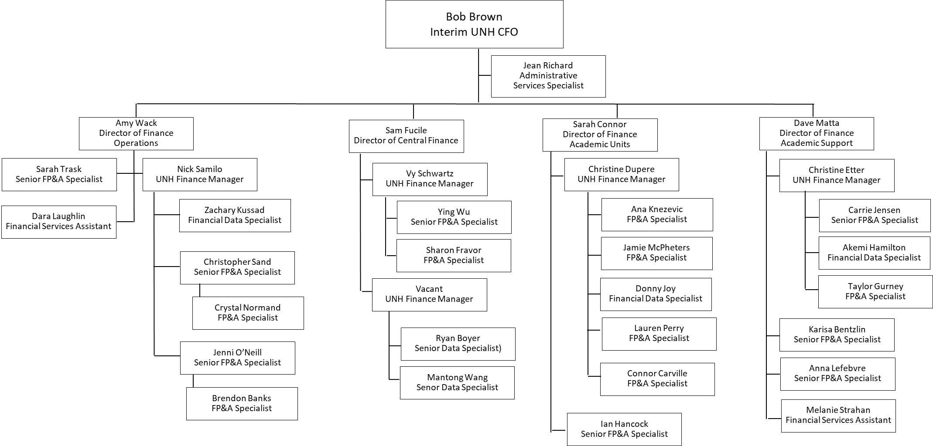
Finance Organization

Slide 3
Finance Organization
* Denotes Shared Services

Slide 4
Finance Department Contacts
Activity | Notes | Email/Website
USNH Finance SharePoint Home Page | USNH home page for all financial resources and forms | USNH Finance Hub-Home
PCard Expenses |  | https://universitysystemnh.sharepoint.com/sites/USNHFinancialServices/SitePages/Purchasing-Card-(PCard)-Program.aspx
Ushop | Procurement -UShop login, training, general procurement inquiries. Invoices – FOAPAL required Note: Submit requisitions in UShop prior to goods or services being purchased. | https://universitysystemnh.sharepoint.com/sites/USNHProcurement/SitePages/UShopNH-2020.aspx
 | Purchasing Matrix: | https://universitysystemnh.sharepoint.com/sites/USNHProcurement/General%20Information/Purchasing%20Matrix.pdf

