Slide 1
Sustainable UNH Library Collections
Tara Lynn Fulton & Jennifer Carroll
10/23/17

Slide 3
Scholarly Publishing Today

Slide 4
The Challenge of Packages
Subscription Requested and Used | Subscription Not Requested but Used
Subscription Requested but Not Used | Subscription Not Requested and Not Used
Subscription Requested & Used | Subscription Not Requested & Used
Subscription Requested & Not Used | Subscription Not Requested & Not Used

Slide 5
Inflation vs. UNH Collection Budget
2007-2017 Average Increases
Collection Budget – 2.53 %
Journal Inflation – 5.92%
Book Inflation – 3.31%
Overall US Inflation – 1.6%

Slide 6
Research Library Budget Trend Survey
In 2017-18:
95% of research libraries received less than 5% budget increase
25% received a budget decrease

Slide 7
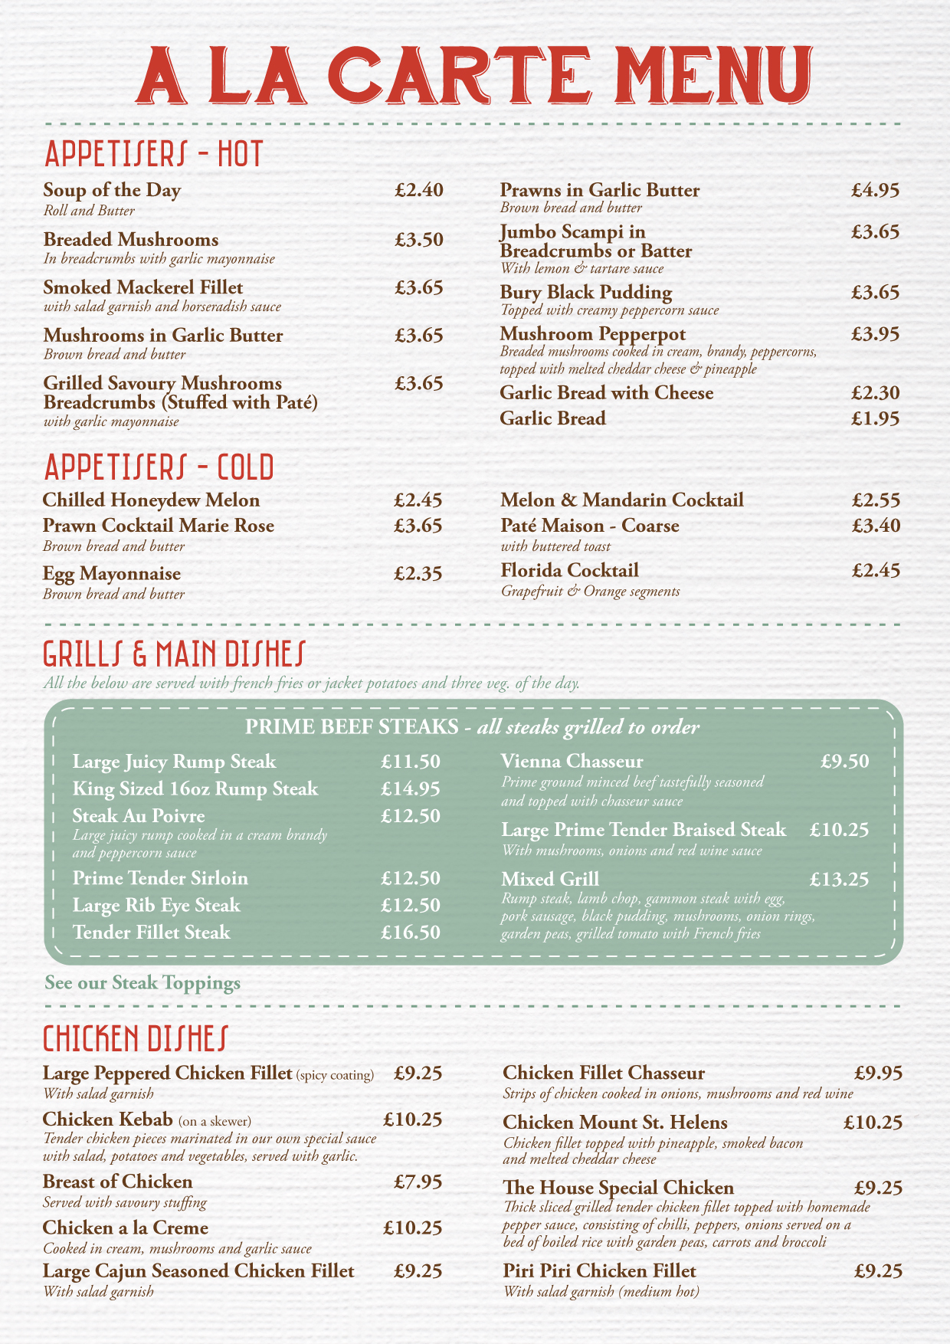
Our Goal? - Sustainability

Slide 8
How Do We Make Progress?
Analyze and optimize packages & transfer high cost/low use titles to per article access
Year 1 (2017-18)Wiley and Elsevier
Year 2 (2018-19) Springer, Sage, and Taylor and Francis
Year 3-5 (2019-22) All smaller packages
Negotiate lower inflation increases on all subscriptions
Purchase just in time vs. just in case
Continue to participate in Open Access initiatives

Slide 9
Year 1: Wiley and Elsevier
Analyzed usage and identified high cost/low use titles
Worked with faculty to identify concerns with proposed titles
Negotiated with publishers
This week – library sending penultimate list of titles for final comments – and final check across departments – accounting for interdisciplinarity
Final lists to be communicated end of Oct.
Changes go into effect Jan. 1, 2018

